Slide 1

College-Compass
Find your way always

Slide 2

PROBLEM STATEMENT:
Freshers often face challenges to reach out their respective faculty cabins and while locating different campus facilities and discovering new areas within the campus.

Slide 3

The solution
This is an app to locate what you need in the college campus , identify
the blocks where staff members are available and
Pinpoint the various campus locations.

Slide 4
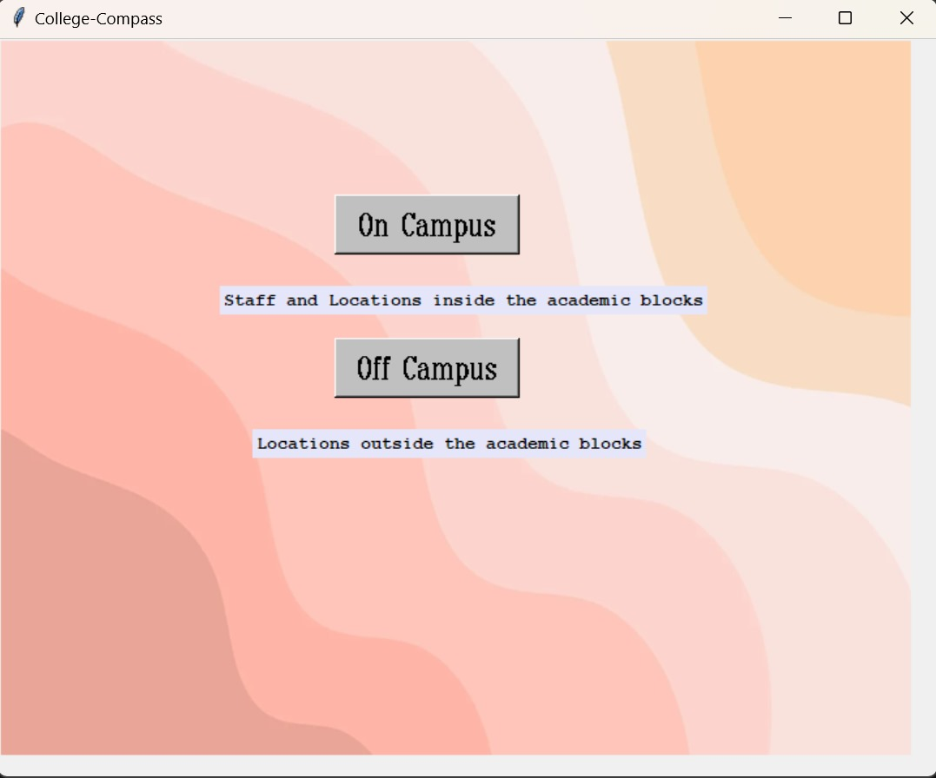
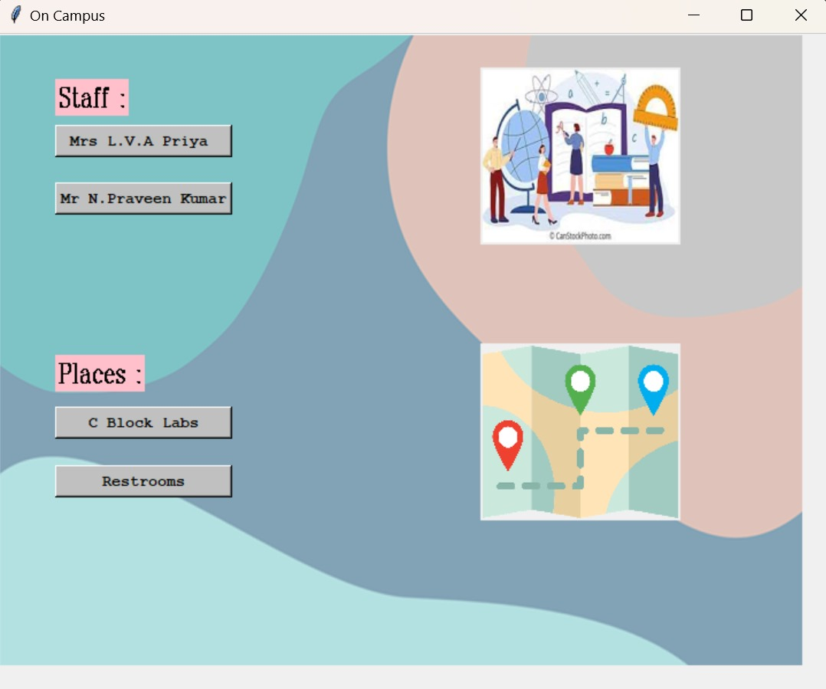
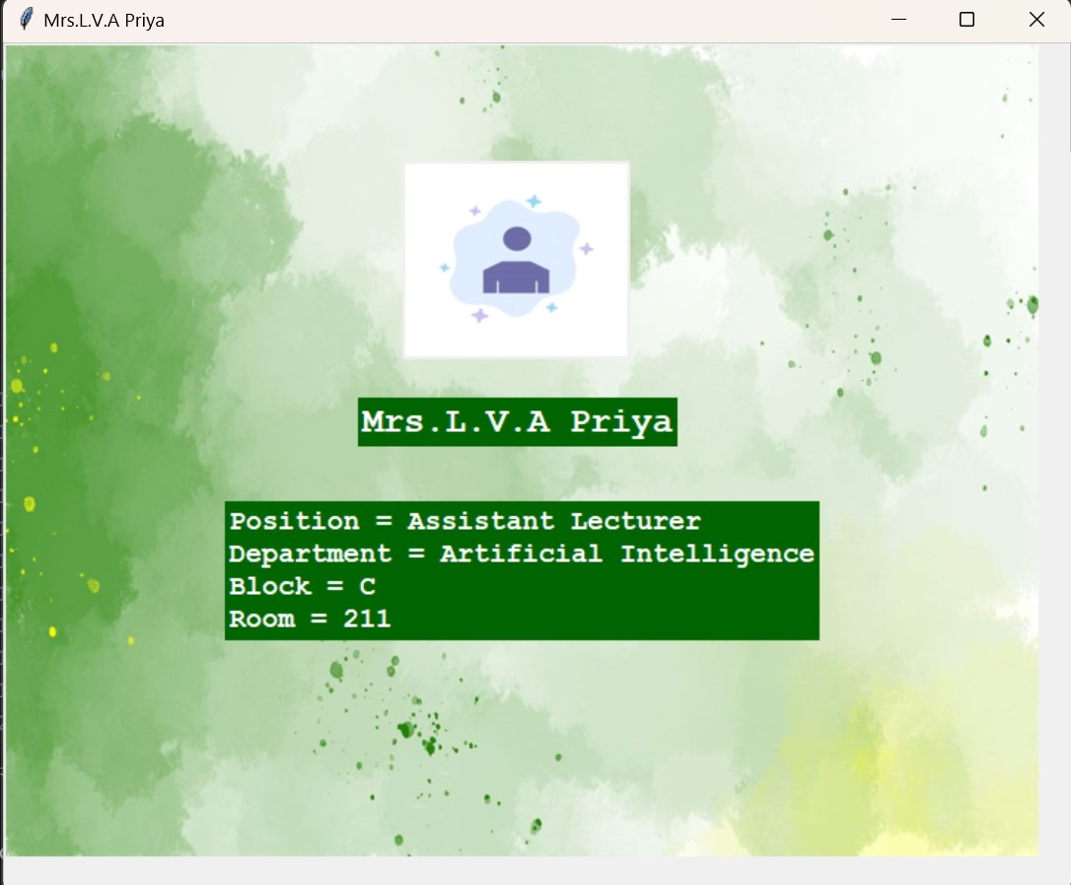
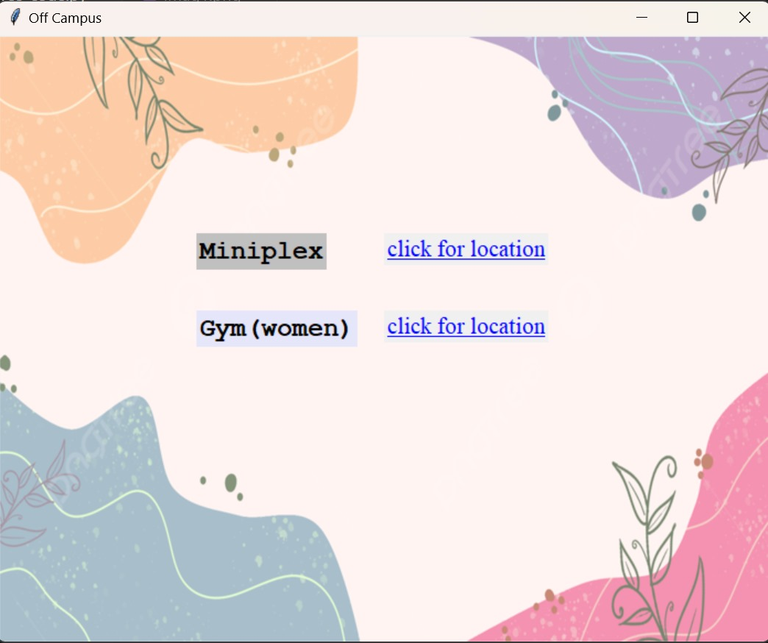
College-Compass

Slide 5

The technology:
GPS + RFID
KEY POINTS :
Facilitates quicker navigation within the campus.
Discovering various locations on campus.
Convenient access to amenities.
Easy access to classrooms , laboratories and seminar halls
faculty in their cabins
You can effortlessly locate joyable places such as auditorium , miniplex , and sports arena

